Slide 1
Canskate Parent Information
Perth Skating Club
2024-2025 Skating Season

Slide 2
CANSKATE IS THE LEARN TO SKATE PROGRAM WHICH ALL OTHERS ARE MEASURED AGAINST
CanSkate offers the best curriculum in Canada. Our flagship learn-to-skate program has taught millions of Canadians to reach their recreational and competitive goals on the ice.
The CanSkate program is geared to beginners of all ages; children, adults, newcomers to Canada and athletes with a disability (AWAD). Whether you are looking to improve basic skating skills for ice sports such as figure skating, hockey, ringette and speed skating, or wish to skate for recreation, fitness and fun, CanSkate will get you there.
Conducted in a fun, friendly environment, the CanSkate program showcases a comprehensive series of balance, control and agility skills, using a nationally-tested and proven curriculum that supports skater success in developing stronger basic skills on the ice.
Millions of Canadians, including World and Olympic figure skating champions and National Hockey League stars, have taken their first steps on the ice with the CanSkate program. Offered at clubs and skating schools across Canada and delivered by NCCP coaches, CanSkate will help you realize your skating goals.

Slide 3
Who we are:
Skate Canada Certified Coaches
Volunteer Board of Directors
Desiree Bellevue
Teri-Ann Kirkham
Chloe Paisley
President – Ashley Leeflang
Vice President – Jim Armstrong
Past President – Amber Corrigan
Treasurer – Krista Strachan
Secretary – Lesley Conlin
Registrar – Ashley Leeflang
Test Chair – Tammy Crain
Social / Website - *Vacant
CanSkate Coordinator - *Vacant
Coaches Representative – Teri-Ann Kirkham
*We are currently seeking volunteers to fill vacant positions, if interested in joining out board please reach out to perthfsc@gmail.com
Program Assistants
Addison
Ainsley
Alison
Dawson
Lisa
Maddie
Raelyn

Slide 4
When you first arrive:
Please arrive to the main lobby of the Perth Community Centre 15 minutes before your group begins
Please sign your skater in at the attendance table
PreCanSkate and CanSkate skaters will follow their coloured stars to the assigned dressing room to put on your skates and helmet.
Your skater can then follow the posted warm up pictures for a pre-session warm up. High Knees, Jumping Jacks, Lunges, Squat, Side Bend, and Warrior Pose
Following your warm-up your skater can then proceed to their assigned door and wait to be welcomed onto the ice at your scheduled time by our Program Assistants & Professional Coaches.
PreCanSkate Group 1 - 9:25 - 9:55,
PreCanSkate 2 - 9:55 - 10:25,
CanSkate - 10:25 - 11:20
Parents are not allowed on the ice at any time, but are required to stay at the rink during the entire CanSkate/PreCanSkate session in case of any injury or bathroom breaks.

Slide 5
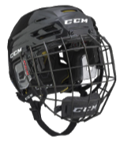
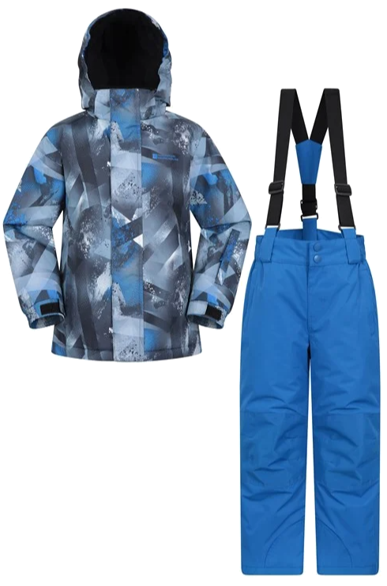
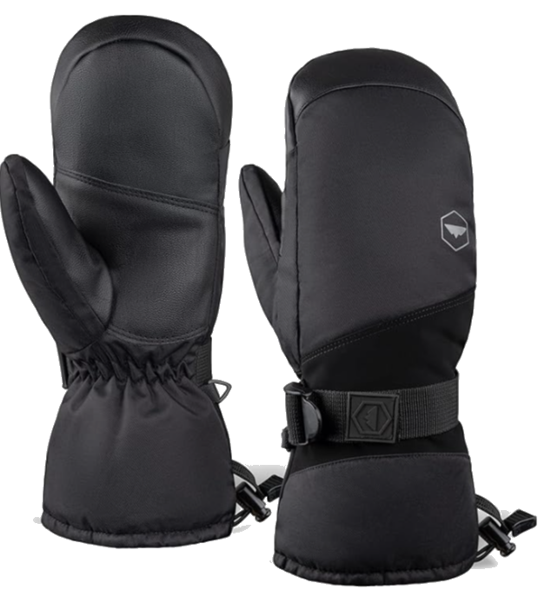
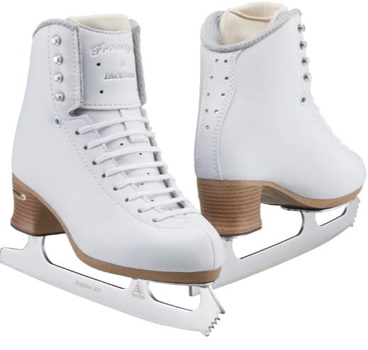
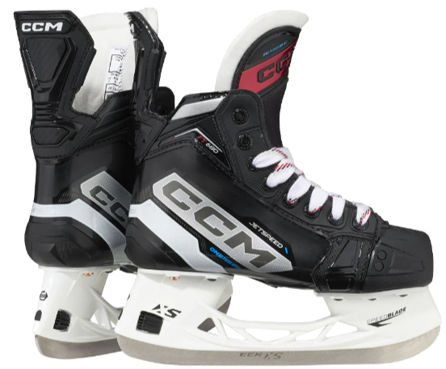
Required Equipment:
CSA Approved Helmet
Skates that have been sharpened
Clothing
CSA approved helmet must be worn until the skater has completed the Stage 5 badge – This is a Skate Canada rule - There are NO exemptions from this policy, as helmets are required for insurance purposes. We recommend skaters in the PreCanSkate and CanSkate programs to wear a cage on their helmet to help protect the skaters face and teeth.
Purchasing appropriate and properly fitting skates for the level of your skater is important. Here are some general guidelines: • Avoid the temptation to buy a larger size for your skater to “grow into.” Skates that are too big will frustrate the skater and hurt their feet. • Firm ankle support is key. Ankles should never appear to fall over. Take the time to tie your skates correctly to improve your skater’s performance and keep your ankles supported. Skates should be laced softly over the toe and front of the boot but snuggly over the ankles. • Look for good quality leather. Leather boots are preferable to vinyl. Moulded plastic skates are not recommended.
Warm mittens
Snowpants or slush pants
Warm jacket
Scarves can be a hazard on the ice and should be avoided.
Excess laces should be tucked or tied up so that they do not drag on the ice (not wrapped around ankles)
Hair should be tied back so your skater can see properly.

Slide 6
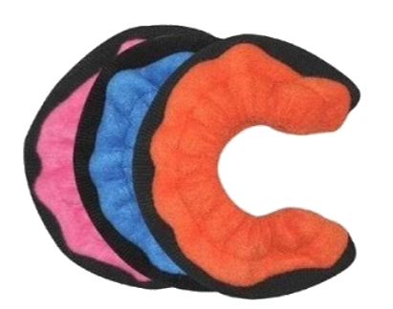
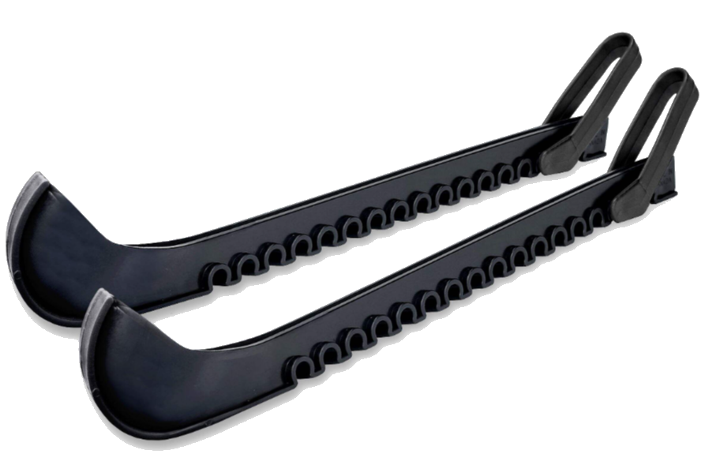
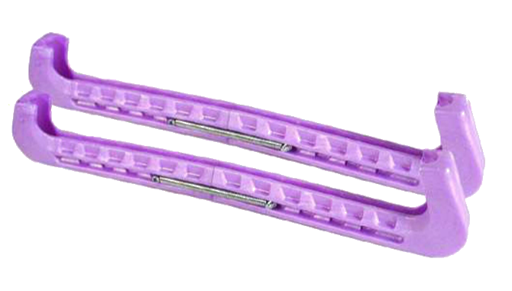
Maintaining your equipment
Ensure you fully dry the blades of your skates following each session with a dry absorbent cloth
Do not store your skates with hard skate guards on as this will cause rust
Ensure you air out skates and dry clothing between sessions
To protect the skate blades, skate guards should be worn in any area that is not protected by rubber mats. Please avoid walking on the cement with your blades
Ensure that your skates are sharpened approx. every 20 hours of skating
Hard skate guards are for walking with skates on. Do not store skates with hard guards, these will cause rust on skate blades.
Cloth skate guards used for storing skates in between sessions

Slide 7
Events & Theme Days
PAJAMA DAY
September 28, 2024
HALLOWEEN / BLACK & ORANGE DAY
October 19, 2024
TAYLOR SWIFT / SUPER-HERO DAY
November 23, 2024
CHRISTMAS PJ PARTY / RED & GREEN DAY
December 21, 2024
JERSEY / SPORTS DAY
January 18, 2025
RAINBOW DAY
February 22, 2025
BEACH DAY
March 22, 2025
Each month our team hosts a theme day where skaters can dress-up
Please ensure your skater continues to wear their properly fitted helmet for these theme days
We also host special events and fundraisers throughout the year that you will be receiving information by email for, please ensure you are updating your calendar with this information

Slide 8
Cancellation days
October 26, 2024
November 30, 2024
Holiday Break
December 28, 2024
January 4 & 11, 2025
January 25, 2025
February 15, 2025
March 15, 2025
As much as we love to be at the rink with our skaters each week, we have cancellation dates related to other needs of the community and our club.
Many of our Program Assistants are competitive figure skaters whose competitions are hosted on weekends in the second half of the season. Without our PAs, we cannot meet our required skater to coach ratios
Please be aware that these cancellations dates were taken into consideration when planning our registration fees for the season

Slide 9
Volunteers
Our volunteers are parents of skaters just like you
If you are open to offering your time or expertise throughout the season, please touch base with one of our amazing executive members to ask how you can help!

Slide 10
Program Assistants
Our program assistants are skaters you see helping our younger athletes with the Blue T Shirts
These program assistants have received special training throughout the season to support our PreCanSkate and CanSkate programs
If you wish to communicate with a member of our club regarding the CanSkate session, you can let a PA know and they will direct you to a professional coach

Slide 11
Review of session format
The CanSkate program is organized into seven progressive stages of learning from PreCanSkate to Stage 6. The fast-paced program introduces skaters to the ABC’s of skating that are FUNdamental skills for all ice sports.
Agility: concentrating on turning and jumping skills.
Balance: concentrating on forward skills, pushing techniques and edges.
Control: concentrating on backwards skills, stopping and speed elements.
The CanSkate session starts with a warm-up led by our program assistants.
Skaters will rotate from each station with continuous movement
The use of the full ice surface, fast track, group learning stations, and circuits will challenge all skaters to push their learning and further their progress by exposing them to more skills.
Skaters are grouped based on skill and badge level as set out by our program guidelines. Grouping of the skaters is an ongoing process as each athlete progresses at their own rate. Skaters may be regrouped from time to time to ensure they are being challenged and exposed to new skills.
Our goal is to have your child moving for 90% of their session.
Sessions end with a group activity and cool-down.
All sessions have the main goal of learning while having fun!

Slide 12
Reading Report Cards PreCanskate
Report cards and badge marking occurs throughout the skating season
As skaters complete badge levels your skater will receive their badge and continue working on the next level
For our PreCanSkate skaters, completion of the first badge means moving to the CanSkate session. This transition will be discussed with parents.

Slide 13
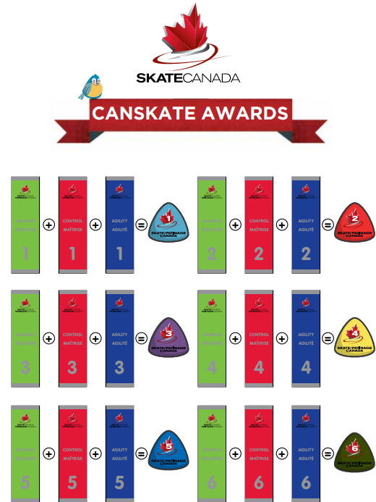
CanSkate Report Card

Slide 14
How to reach us
Communication is very important to the success of our programs so please do not hesitate to ask questions and give us your feedback at Perthfsc@gmail.com
For updates and more information please visit our website - https://perthfsc.uplifterinc.com/
Join us on Facebook at Perth Figure Skating Club.
Speak directly with a member of our executive Saturday mornings at the CanSkate table.
Thank you for participating in our Program. We hope you and your skater(s) have a wonderful skating season and one that promotes an interest in life-long participation in skating.

